Slide 1
Lecture 12: Filtering and Aggregation & Focus+Context
DS 4200
Fall 2022
Prof. Ab Mosca (they/them)
Northeastern University
Slides and inspiration from Cody Dunne, Michelle Borkin, Dylan Cashman, Miriah Meyer

Slide 2
Last Class
We:
Reviewed Interaction
Reviewed Faceting
Any Questions?

Slide 3
Today
Filtering and Aggregation
Focus+Context

Slide 4




Visualizing Big Data
Notes:
One big challenge when designing visualizations is figuring out how to effectively fit large amounts of data onto a visualization shown on a small screen.
Over the years, numerous approaches to this challenge have been used <next>

Slide 5

Visualizing Big Data
Faceting – Split data into multiple views
Interaction – Let user manipulate a single view
Aggregate and Filter – Reduce amount of data visualized
Focus+Context – Embed focused information
Notes:
These five tactics are the most common approaches to visualizing large amounts of data on a small screen.
<read>
We’ll talk about all of these in the next few lectures, but for today <next>

Slide 6
Visualizing Big Data
Faceting – Split data into multiple views
Interaction – Let user manipulate a single view
Aggregate and Filter – Reduce amount of data visualized
Focus+Context – Embed focused information
Notes:
These five tactics are the most common approaches to visualizing large amounts of data on a small screen.
<read>
We’ll talk about all of these in the next few lectures, but for today <next>

Slide 7
Aggregation and Filtering

Slide 8
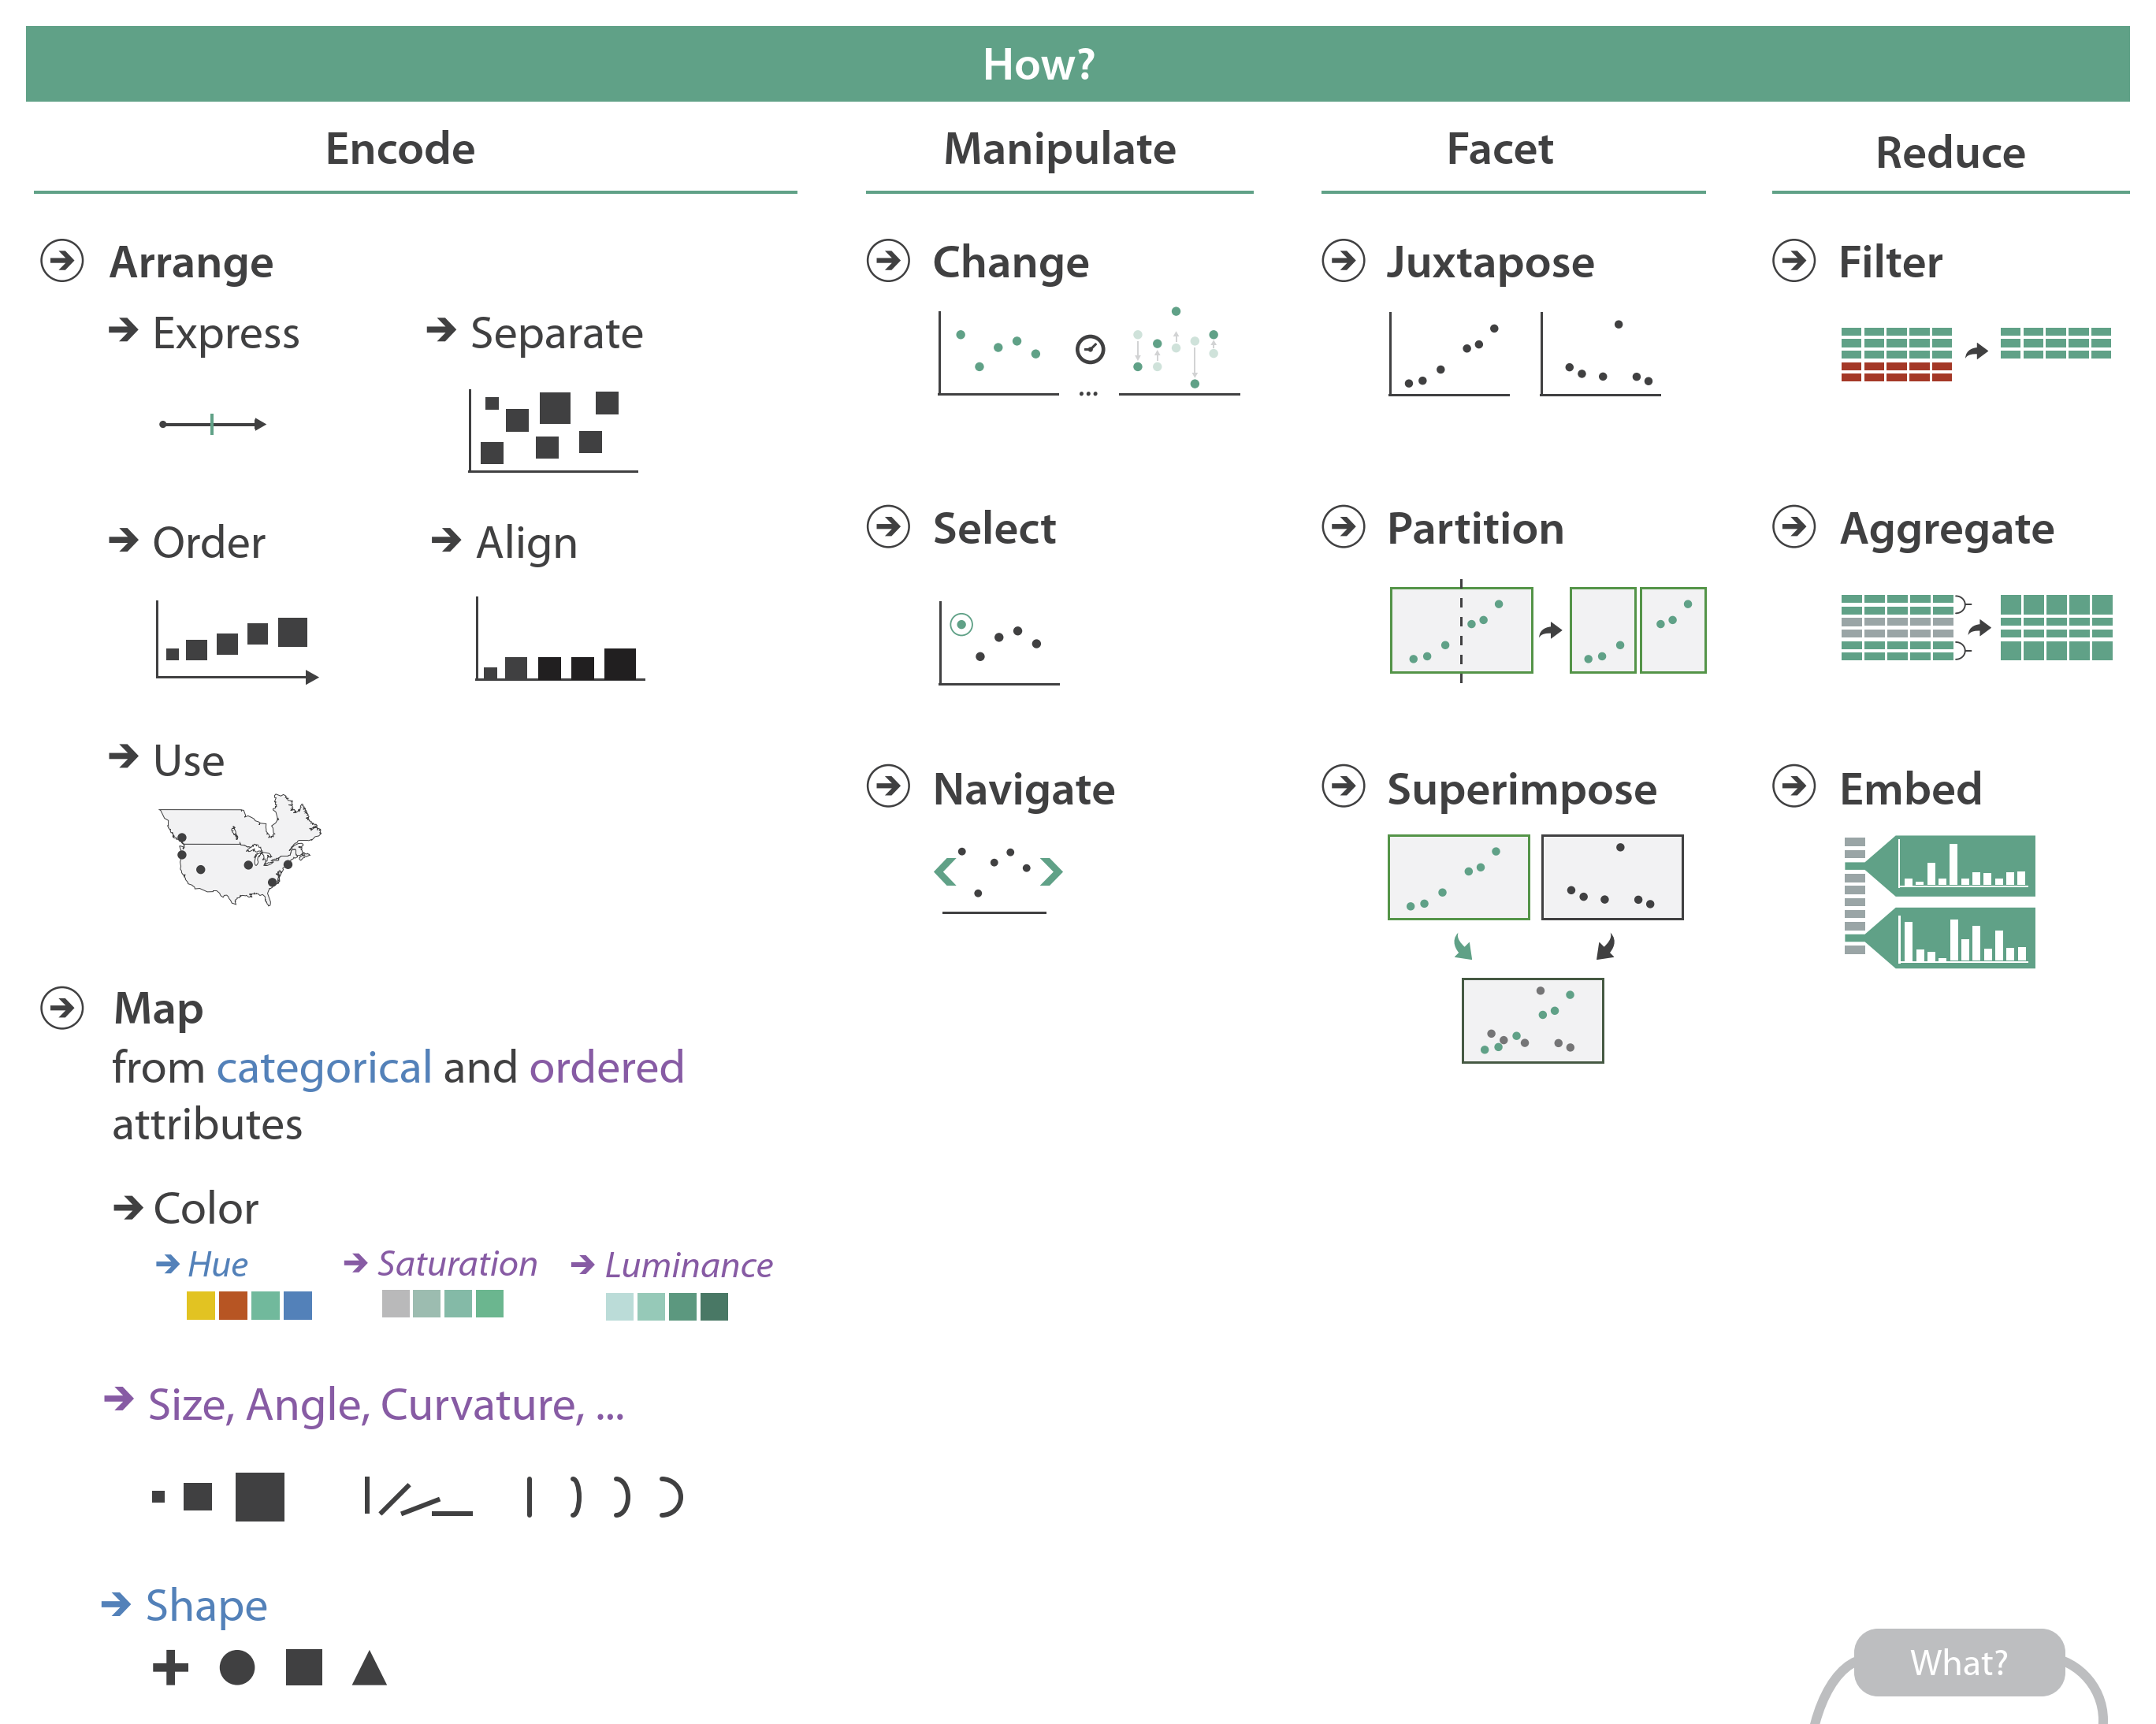
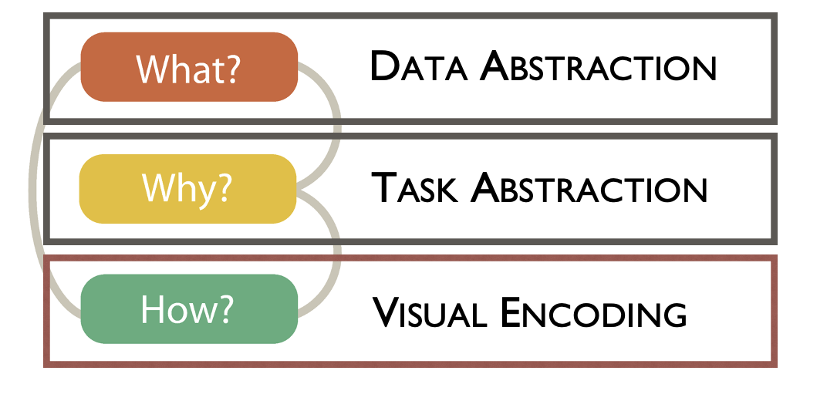
Munzner’s Design Pipeline
From Munzner’s book
Notes:
Let’s start by looking at reduction techniques fit into Munzner’s design pipeline.
We talked about reduction briefly when we looked at Navigate interactions.
Today we’ll look more in-depth at reduction at its own step in the design pipeline.

Slide 9
Caveats to Filtering & Aggregation
Be careful not to hide important details
Keep in mind your audience
→ Will they understand the resulting data?
→ Will they remember they’re looking at reduced data?
Notes:
Reducing the amount of things to show on a visualization has the benefits of producing a clearer and easier to use visualization, but should be done with care.
In particular, when you’re using reduction techniques you need to be careful not to hide important details in your data
And you also need to keep in mind your audience’s expertise and whether they will be able to understand how reduced data represents the original dataset.
We’ll touch more on these caveats as we learn about different reduction techniques.

Slide 10
Filtering vs. Aggregation
Filter → Eliminate (hide) elements
Aggregate → Create new element(s) representing multiple
Notes:
Let’s start by defining Filtering and Aggregation, and looking at the difference between the two.
Filtering is when we eliminate or hide elements in our data.
Aggregation is when we create new elements in our data that represent multiple original elements.
<next>

Slide 11
Filtering vs. Aggregation
Filter → Eliminate (hide) elements
Aggregate → Create new element(s) representing multiple
Pros:
Easy to understand
Easy to compute
Pros:
No missing elements
Easy for the user to forget elements
Can require sophisticated expertise from the user
Cons:
Cons:
Notes:
Of course, each approach comes with its own pros and cons.
For example, with filtering….
Okay, next let’s look at how exactly each of these approaches can be implemented.

Slide 12
Filtering
Notes:
First, filtering.
Filtering is typically achieved by allowing the user to perform dynamic queries on items and / or attributes of the data.
Item filtering is with we eliminate items based on a value.
Attribute filtering is when we eliminate attributes from our visualization.
You might notice that these are similar to the outcomes of certain interactions we discussed in last lecture.
<next>

Slide 13
Filtering
Item filtering
→ eliminate items based on value
Notes:
First, filtering.
Filtering is typically achieved by allowing the user to perform dynamic queries on items and / or attributes of the data.
Item filtering is with we eliminate items based on a value.
Attribute filtering is when we eliminate attributes from our visualization.
You might notice that these are similar to the outcomes of certain interactions we discussed in last lecture.
<next>

Slide 14
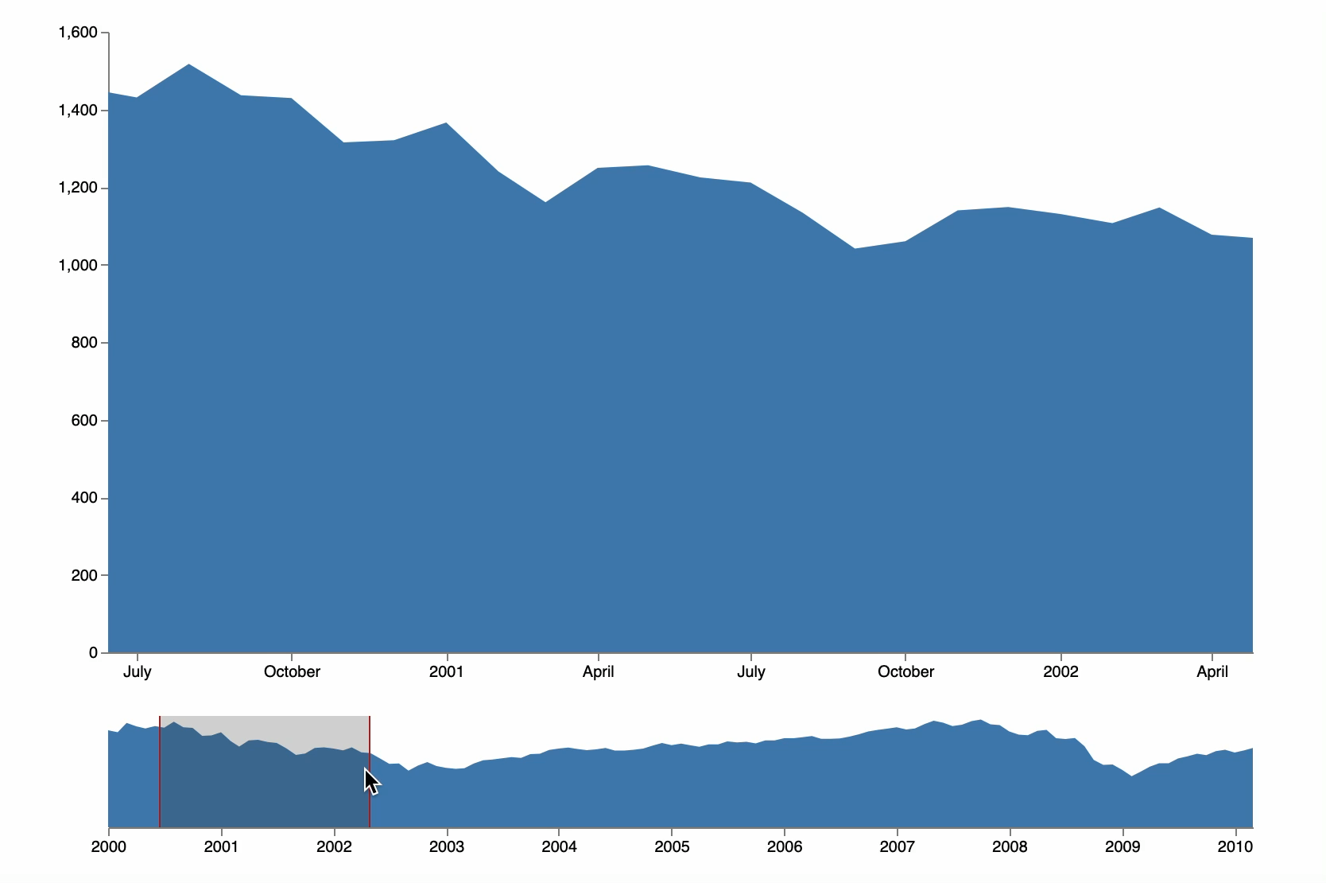
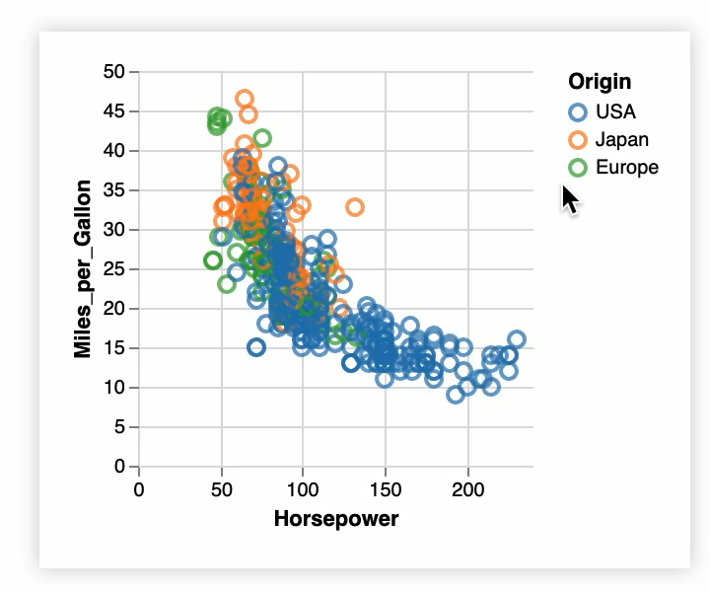
Filtering
Item filtering
→ eliminate items based on value
https://vega.github.io/vega/examples/overview-plus-detail/
https://vega.github.io/vega/examples/interactive-legend/
Notes:
First, filtering.
Filtering is typically achieved by allowing the user to perform dynamic queries on items and / or attributes of the data.
Item filtering is with we eliminate items based on a value.
Attribute filtering is when we eliminate attributes from our visualization.
You might notice that these are similar to the outcomes of certain interactions we discussed in last lecture.
<next>

Slide 15
Filtering
Attribute filtering
→ eliminate attributes from display
Notes:
First, filtering.
Filtering is typically achieved by allowing the user to perform dynamic queries on items and / or attributes of the data.
Item filtering is with we eliminate items based on a value.
Attribute filtering is when we eliminate attributes from our visualization.
You might notice that these are similar to the outcomes of certain interactions we discussed in last lecture.
<next>

Slide 16
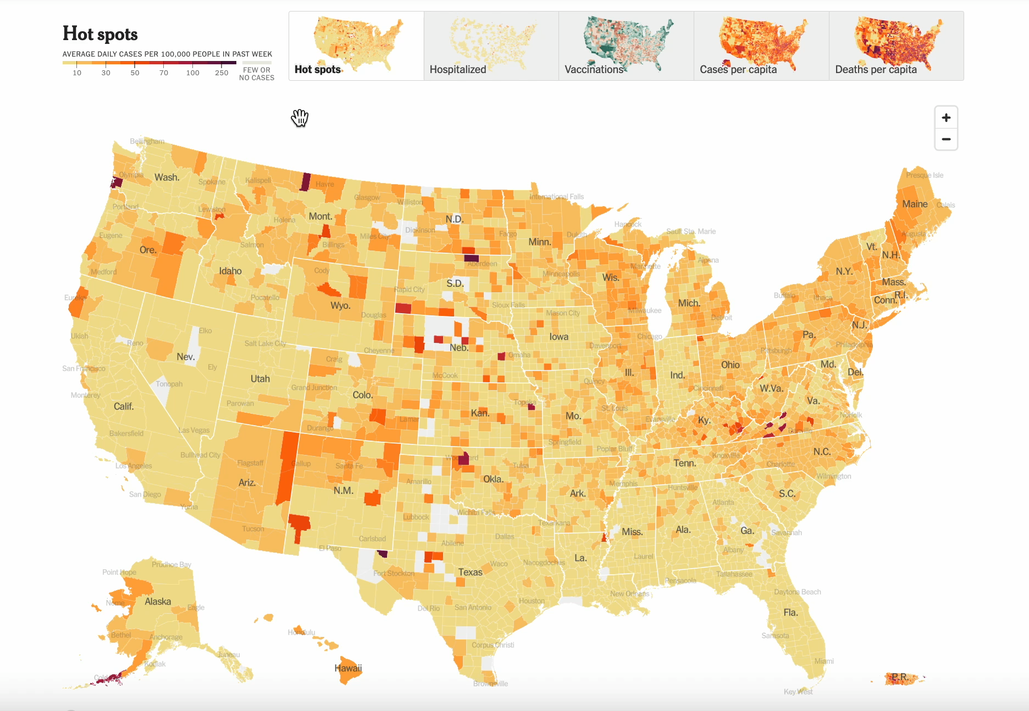
Filtering
Attribute filtering
→ eliminate attributes from display
https://www.nytimes.com/interactive/2021/us/covid-cases.html
Notes:
First, filtering.
Filtering is typically achieved by allowing the user to perform dynamic queries on items and / or attributes of the data.
Item filtering is with we eliminate items based on a value.
Attribute filtering is when we eliminate attributes from our visualization.
You might notice that these are similar to the outcomes of certain interactions we discussed in last lecture.
<next>

Slide 17
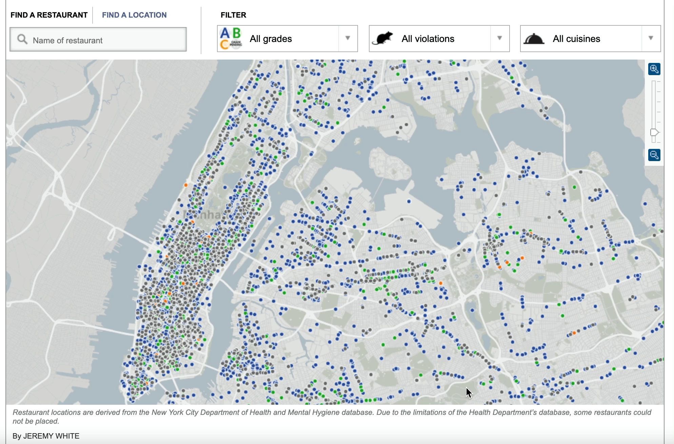
Filtering
Item filtering
→ eliminate items based on value
Attribute filtering
→ eliminate attributes from display
http://www.nytimes.com/interactive/dining/new-york-health-department-restaurant-ratings-map.html
Notes:
Often, visualizations will allow for both types of filtering.
For example, in this visualization I can filter which attributes are shown by selecting a specific violation, and I can filter which items are shown by selecting a specific range of values for grades.

Slide 18

Filtering
How can we help the user remember that they are only viewing a subset of the data?
Sketch some ideas
Notes:
One popular approach for adding filtering to visualizations is to use something called scented widgets.
Scented widgets are widgets that enable interaction, and also have additional information attached to them.
For example, each of the widgets shown here includes additional encoding information about the visualization.
For example, that height corresponds to # of visits, and that gradients corresponds to recency of visits.
This helps communicate encoding information to the user, and can also help them keep track of hidden or filtered data.

Slide 19
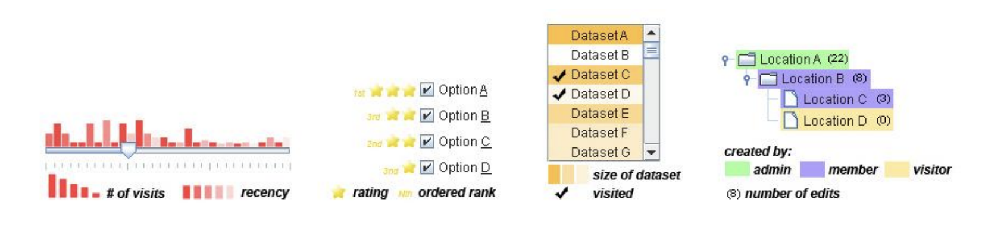
Filtering
Scented Widgets
Help address the risk of forgetting information
(Willet 2007)
Notes:
One popular approach for adding filtering to visualizations is to use something called scented widgets.
Scented widgets are widgets that enable interaction, and also have additional information attached to them.
For example, each of the widgets shown here includes additional encoding information about the visualization.
For example, that height corresponds to # of visits, and that gradients corresponds to recency of visits.
This helps communicate encoding information to the user, and can also help them keep track of hidden or filtered data.

Slide 20
Aggregation
Notes:
Our second reduction technique is aggregation.
Aggregation is the process of creating one element to represent many elements.
Like filtering, it can be done at the item level – so creating a new row in the dataset to represent many rows.
Or at the attribute level – so creating one attribute to represent many similar attributes or performing dimensionality reduction.
Let’s look at examples of each of these.

Slide 21
Aggregation
Item aggregation
→ Create one item to represent many
Notes:
Our second reduction technique is aggregation.
Aggregation is the process of creating one element to represent many elements.
Like filtering, it can be done at the item level – so creating a new row in the dataset to represent many rows.
Or at the attribute level – so creating one attribute to represent many similar attributes or performing dimensionality reduction.
Let’s look at examples of each of these.

Slide 22
Aggregation
Item aggregation
→ Create one item to represent many
bins (aggregates) of data
Notes:
One example of item aggregation representing item values in a histogram. In this case, we create bins, or aggregates, of different attribute values.

Slide 23
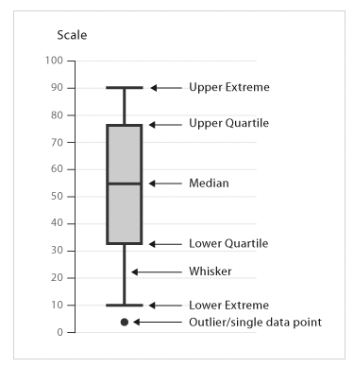
Aggregation
Item aggregation
→ Create one item to represent many
https://datavizcatalogue.com/methods/box_plot.html
https://bl.ocks.org/mbostock/4061502
Notes:
Another example are box and whisker plots. These plots represent many items as one through summary statistics.

Slide 24
Aggregation
Attribute aggregation
→ Collapse / reduce attributes
Notes:
An example of attribute aggregation through dimensionality reduction is calculating summary attributes for your dataset, such as average or spread.

Slide 25
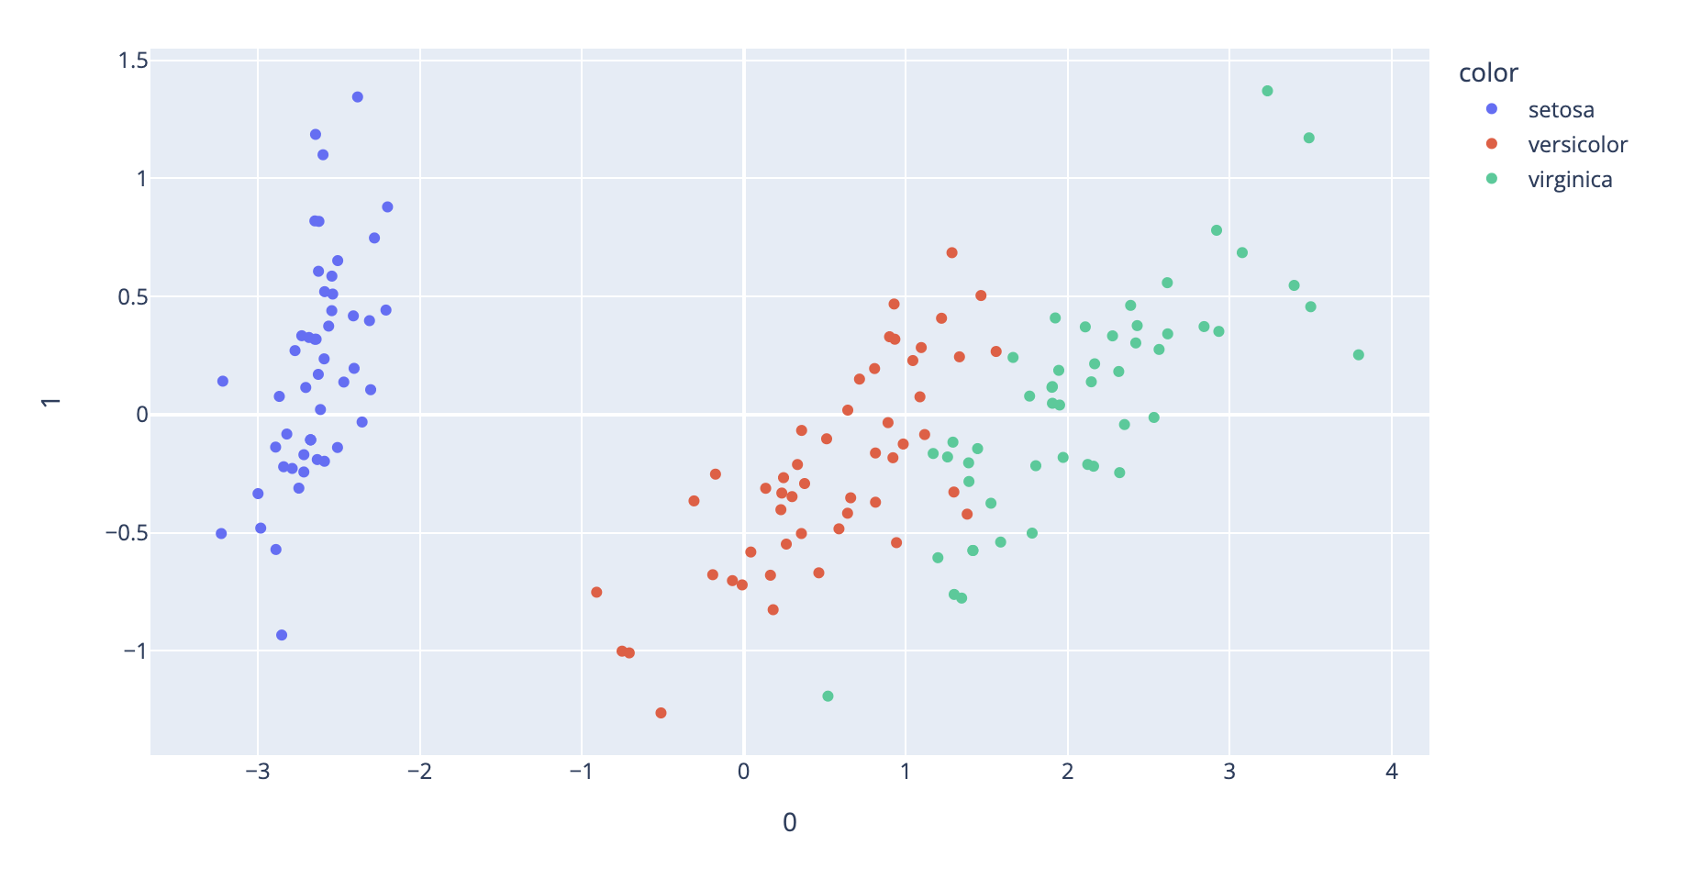
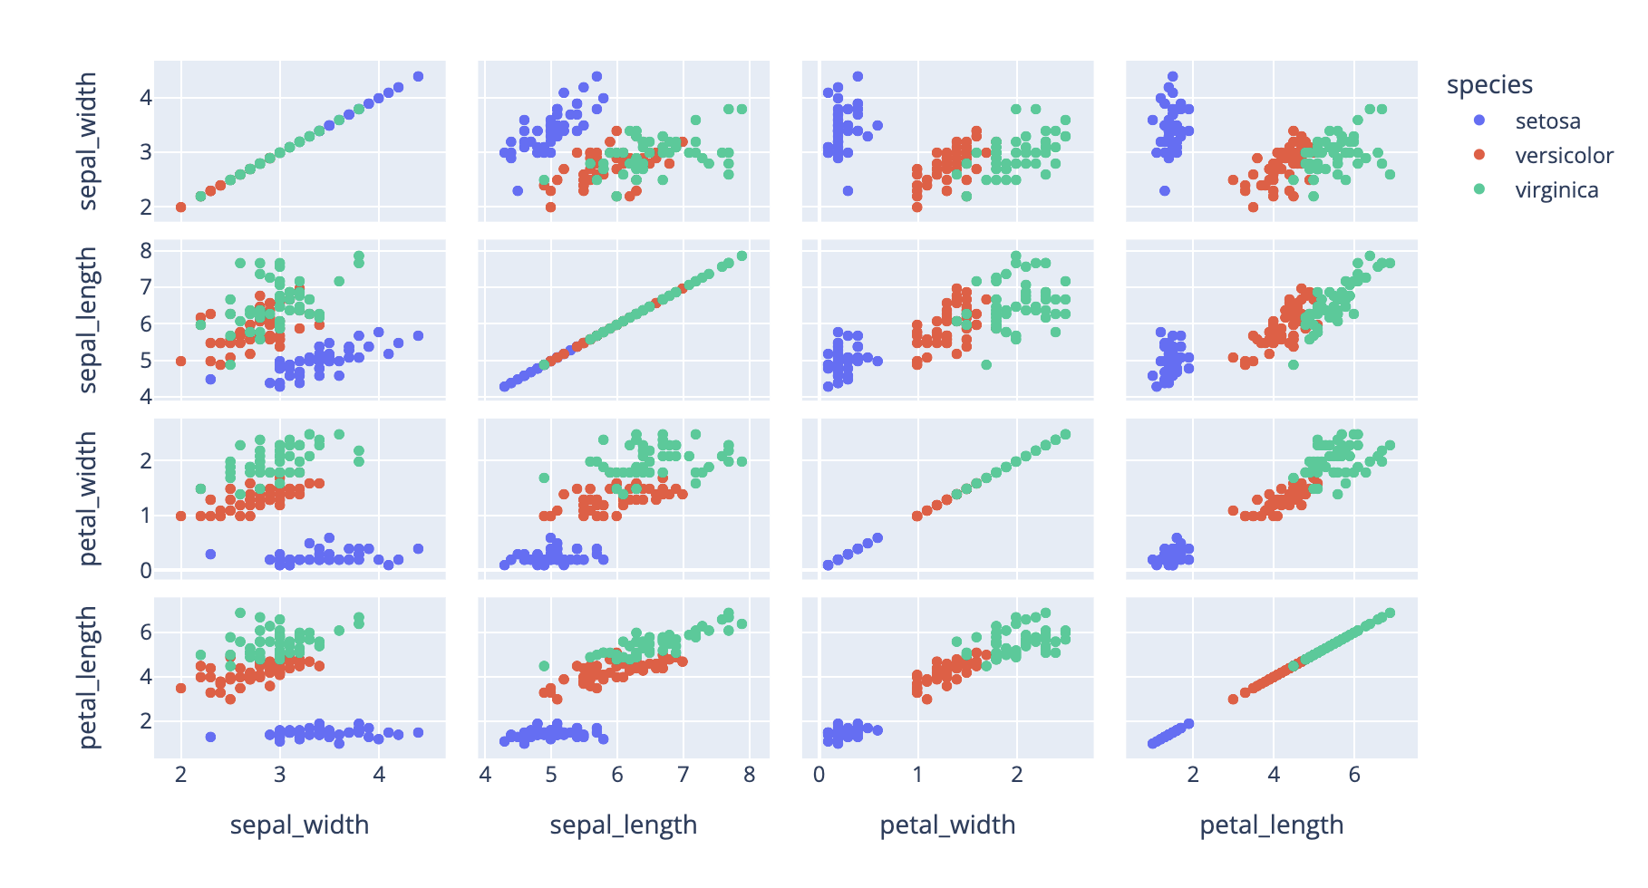
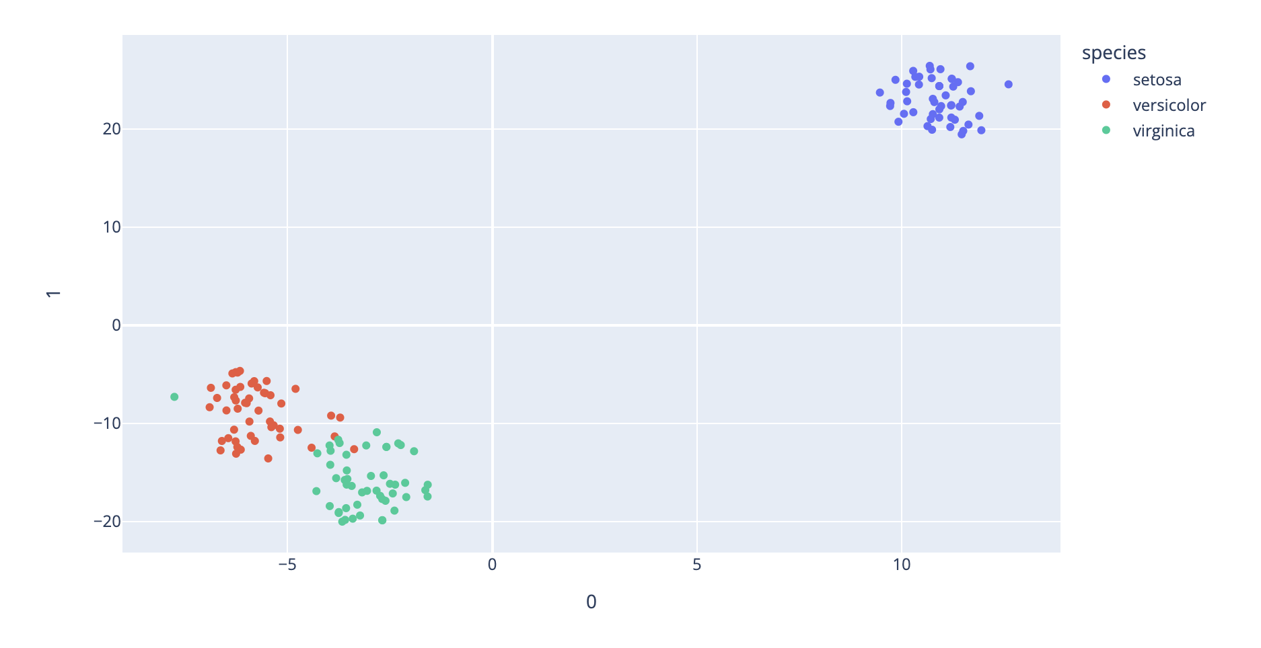
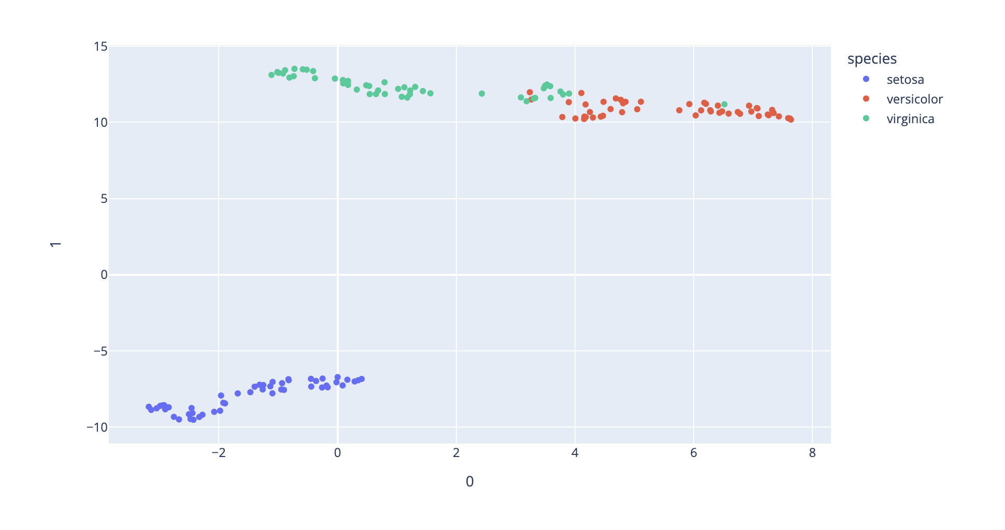
Aggregation
Attribute aggregation
→ Dimensionality reduction
PCA
t-SNE
UMAP
https://plotly.com/python/pca-visualization/
https://plotly.com/python/t-sne-and-umap-projections/
Notes:
An example of attribute aggregation through dimensionality reduction is calculating summary attributes for your dataset, such as average or spread.

Slide 26
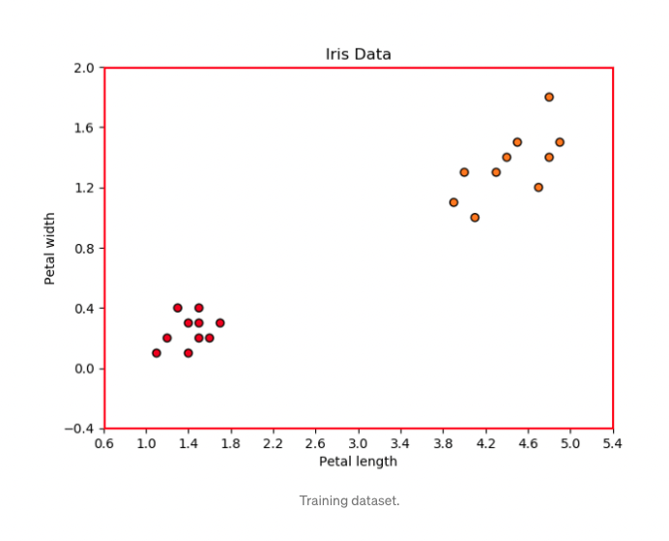
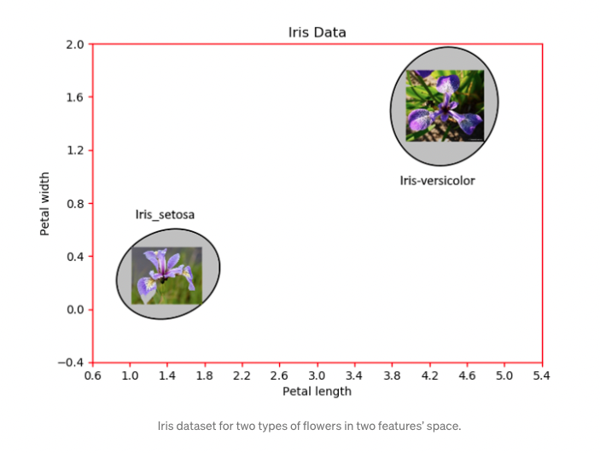
Aggregation
Attribute aggregation
→ Group by similarity measure
https://towardsdatascience.com/17-types-of-similarity-and-dissimilarity-measures-used-in-data-science-3eb914d2681
Notes:
An example of attribute aggregation through similarity measure is clustering. When you cluster, you calculate distances between points (i.e. similarity), and then reduce your attribute space by considering different clusters of points instead of considering all attributes individually.

Slide 27
Aggregation
Spatial aggregation
→ Collapse by spatial similarity
Warning! boundary definition can dramatically change data analysis
Notes:
Last but not least, when we’re talking about aggregation, we also have to consider spatial data.
One type of aggregation in this area that you’re probably very familiar with is aggregating geospatial data. For example, aggregating cities into states or provinces and states or provinces into countries.
One thing to be careful of with Spatial aggregation is that different boundaries or aggregations can lead to very different results.
For example here, there are three examples of spatial aggregation where background color represent density of points. You can see how depending on the aggregation areas there are significantly different densities in the middle of the map.
<next>

Slide 28
Aggregation
Spatial aggregation
→ Collapse by spatial similarity
Gerrymandering
http://www.npr.org/sections/thetwo-way/2017/03/11/519839892/federal-court-rules-three-texas-congressional-districts-illegally-drawn
Notes:
One real world example of the implications of this is gerrymandering, which is entirely based on the knowledge that different spatial aggregations can significantly change how a dataset is represented.

